Slide 1
Student Seminar: Exploiting Two Factor Authentication of Android and IOS
Robin Solignac
235020

Slide 2
1. Introduction: The 2 Factors Authentication Model

Slide 3
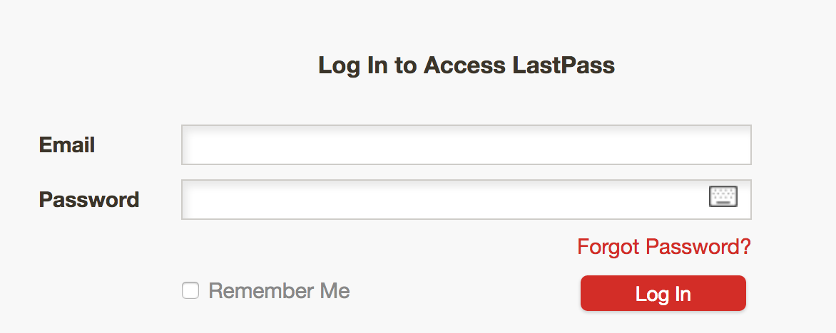
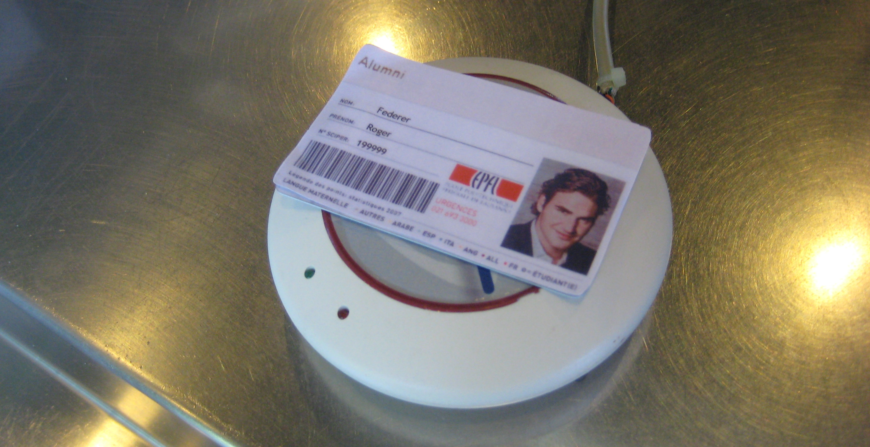
1. Presentation of 2FA model The concept
Combination of 2 access control in order to authenticate
Something you know + Something you have
Main goal: prevent authentication by third party in case of compromised password or main communication channel

Slide 4
1. Presentation of 2FA model The choice of smartphones
Majority of online modern 2FA use (smart)phone as “something you have”
Convenient: Don’t require the user to carry yet another card or devices
Available: Large majority of user have one
Reachable & Out of band: services can send message to it without using the main communication channel
Implement by Google, Microsoft, Amazon, Twitch, Twiter, Visa, …

Slide 5
Presentation of 2FA model 2FA one smartphone

Slide 6
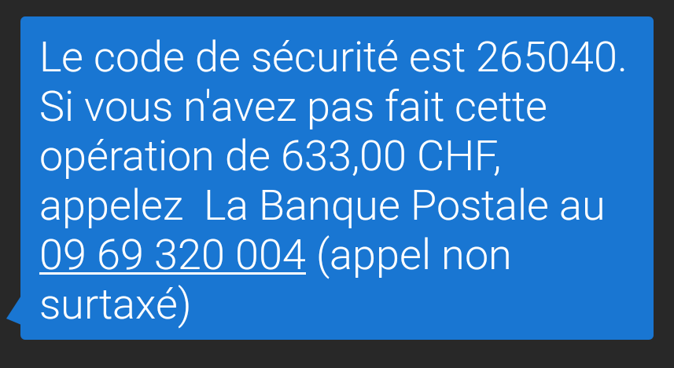
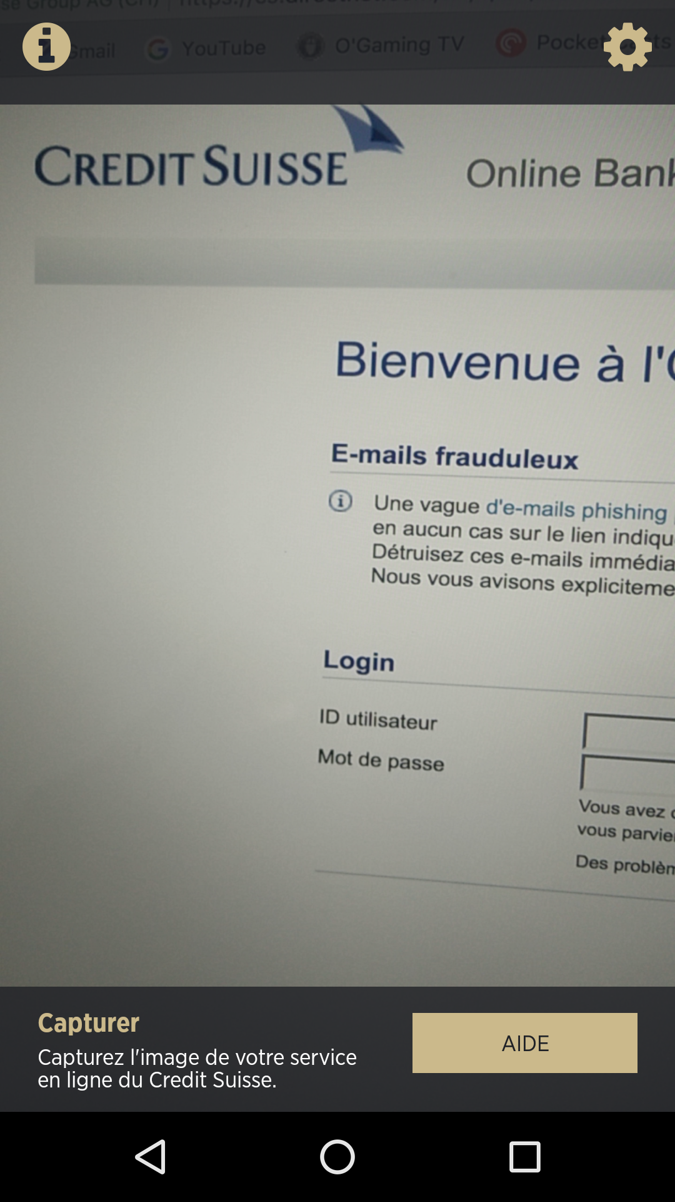
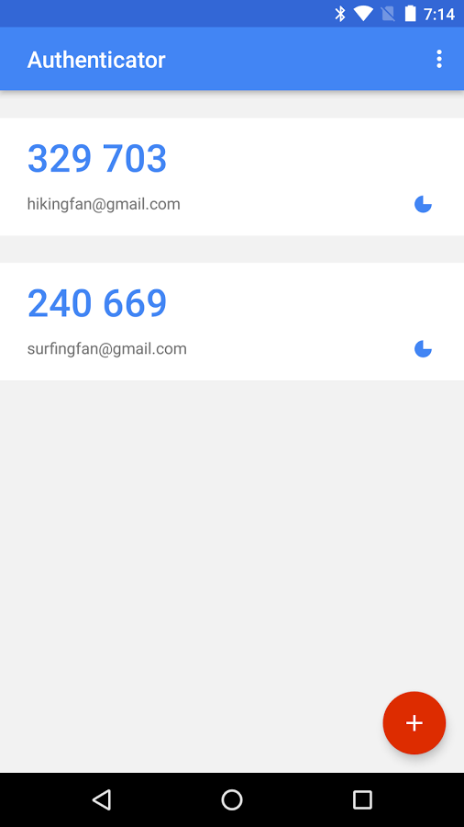
1. Presentation of 2FA model Smartphone 2FA implementation
SMS One Time Password (OTP)
Dedicated application
Can rely on OTP or not

Slide 7
Presentation of 2FA model

Slide 8
2. Key concepts

Slide 9
2. Key concepts Synchronization
Actions performed one devices will have impact on the other
Make use of the 2 smoother
Purposely implements by developers
Blur the line (Air-gap) between the two

Slide 10
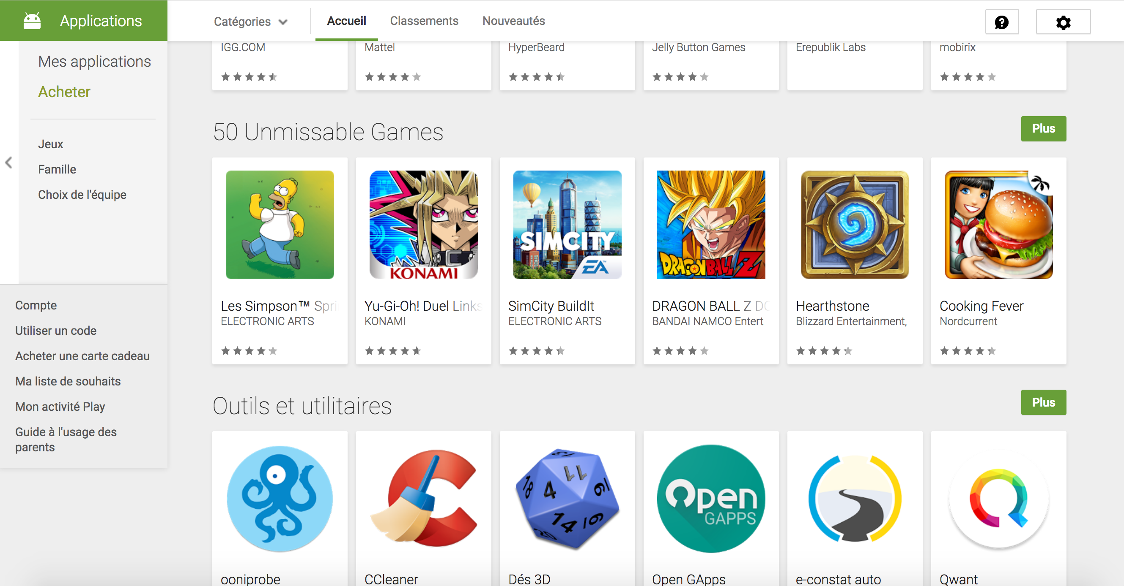
2. Key concepts Synchronization: Google play store website
Possibility to install, from the browser, applications on the phone
Need to be logged under the same Google account
Authorization confirmed from the browser too

Slide 11
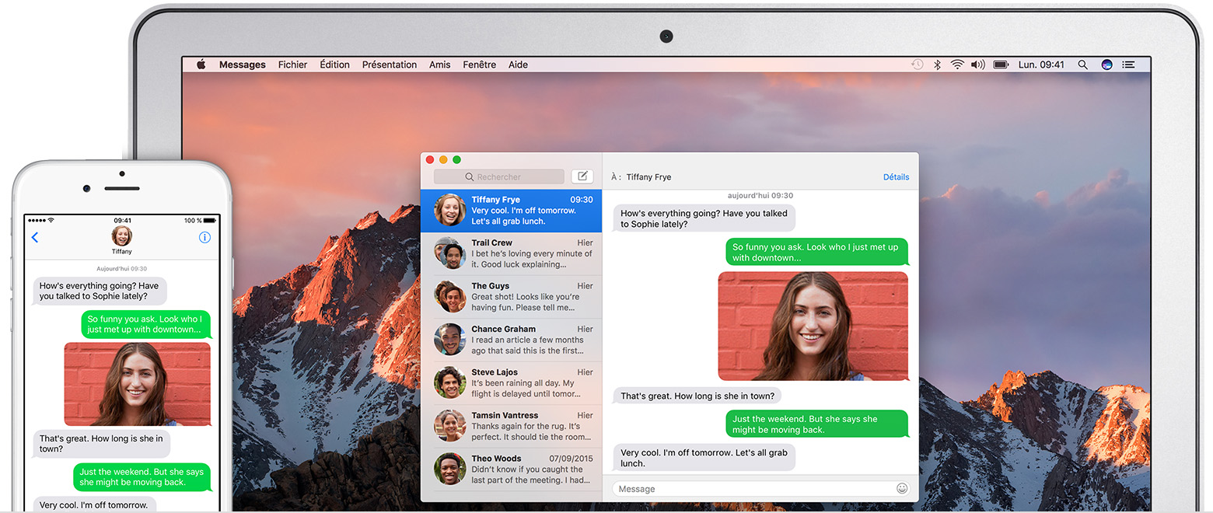
2. Key concepts Synchronization: Apple Continuity
If user posses an IPhone and a Mac, ability to send and read SMS and IMessages from the mac.
Message stored in clear on the mac
Off by default
Need to be on the same LAN

Slide 12

2. Key concepts Synchronization: Browser Sync
Synchronization of Bookmarks, history and open tabs between devices
Available on majority of popular browser
Sync if logged under the same user account

Slide 13
2. Key concepts MitB: Man in the browser attack
Stronger Variant of Man in Middle attack. the attacker can do everything a browser can.
Like man in the middle:
Read and modify all data exchanged
Send arbitrary data in the name of the user
Unlike man in the middle:
Read and modify encrypted data before encryption & after decryption
Read and modify browser related information: settings, cookies, bookmarks, history.

Slide 14
3. 2FA Attacks

Slide 15
3. 2FA Attacks The model
The PC is compromised (physically stolen, Malware, malicious plugin, …)
MitB attack is performed
Connection to the service is hijacked (via password or cookie)
To complete authentication (or transaction) OTP\TAN is send via SMS to victim phone
Phone is sane and run either on Android or Ios

Slide 16
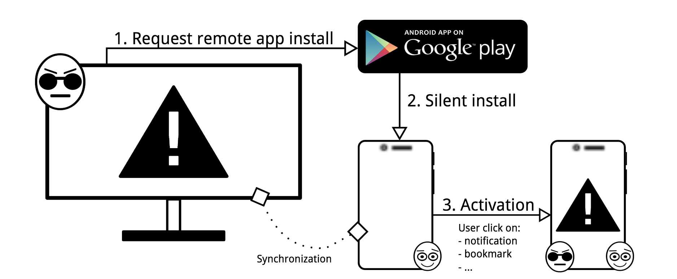
3. 2FA Attacks Android
Form MitB (here Chrome) hijack Google session
Remotely Install SMS stealing app from playstore
App will forward OTP and TAN to attacker
2 difficulties:
Bypass Google Bouncer
Activate the app

Slide 17
3. 2FA Attacks Android | Google Bouncer
Automated malware analysis tool deployed on Playstore
Analyses all uploaded apps
Static and dynamic analysis
Recent work show its easy to bypass.
Exemple: execute malicious code remotly via web-view

Slide 18
3. 2FA Attacks Android | App activation
t
t

Slide 19
3. 2FA Attacks Ios

Slide 20
4. Discussion

Slide 21
Presentation of 2FA model

Slide 22
Presentation of 2FA model

Slide 23
Presentation of 2FA model

Slide 24
Presentation of 2FA model

Slide 25
Images sources
Epfl website: http://camipro.epfl.ch/paiement
Google Authenticator presentation on playstore : https://play.google.com/store/apps/details?id=com.google.android.apps.authenticator2
Apple website : https://support.apple.com/fr-ch/HT204681
Personal screenshots

